Slide 1
Thrift Store
Project By:
Vishakha Vinayak
Arthi Ganesan
Madhurima Chatterjee

Slide 2
Thrift Store - E-commerce - WholeSale Supplier
In addition to local buying and selling, we have implemented an E-commerce website for our Thrift Store. The Thrift Store Dealers get their products in bulk stock from WholeSale Suppliers who ensure to provide high-quality products at a reasonable price to a Dealership for sale.
Features:
The WholeSale Supplier role has a login through which he logs in and clicks on add products to inventory.
The WholeSale Suppliers can create products with their name, price, category, and quantity with a product image for the Dealer to purchase.
The Supplier can view the Total Revenue for the products in his inventory.

Slide 3
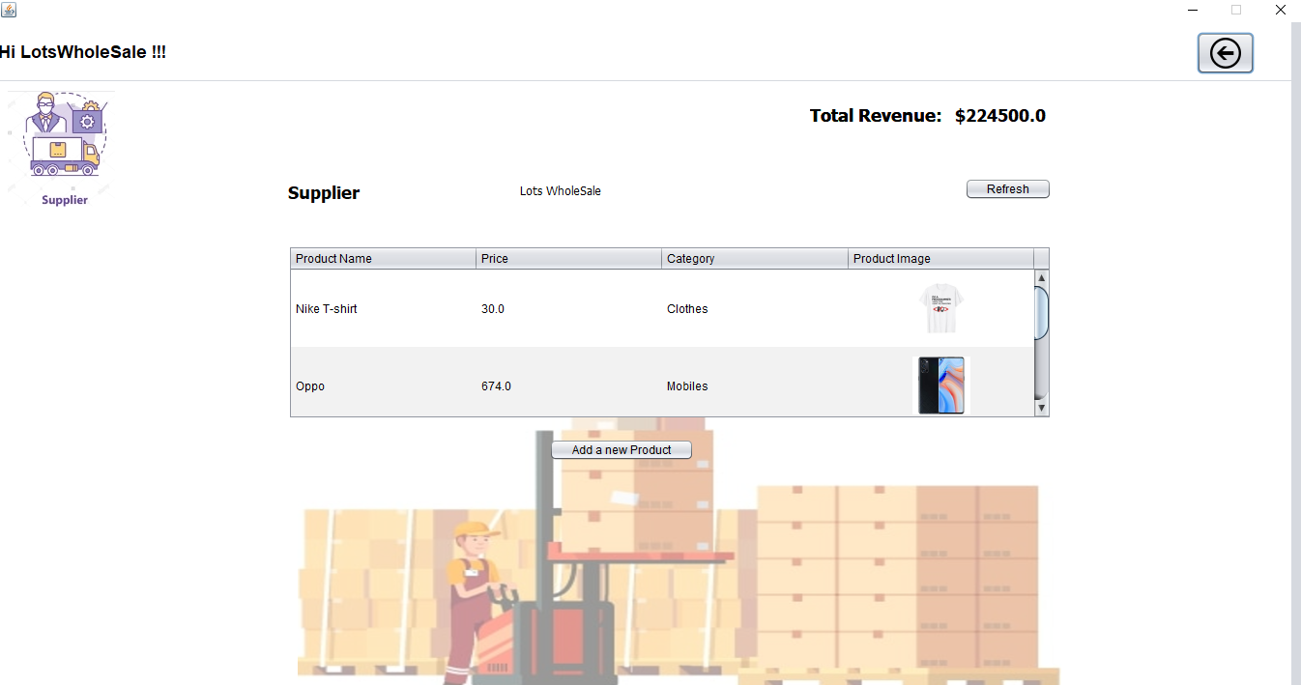
Thrift Store - E-commerce - Supplier Screen

Slide 4
Thrift Store - E-commerce - Dealer
The Dealers in Thrift Store purchase their products from the WholeSale Suppliers where they can get their products in bulk quantity at a reasonable price. The Dealers make sure that these products are available for the customers to purchase online through the Thrift Store E-commerce website.
Features:
The Dealer role has a login through which he logs in and clicks on add products to inventory.
The Dealer can see a table that displays the list of Wholesale Suppliers. By selecting the Supplier and clicking on the ‘View products’ button he can view the product list under the supplier.

Slide 5
Thrift Store - E-commerce - Dealer
The Dealer can enter the number of quantities which he requires and adds the product to his product inventory. The Dealer can view the total revenue for the purchase and he can also remove the items from the product inventory if needed.
Once the Dealers chooses the number of quantities for purchase the original product quantity will get reduced from the supplier and it will get added back to the original product quantity if the dealer removes the item from his product inventory cart.

Slide 6
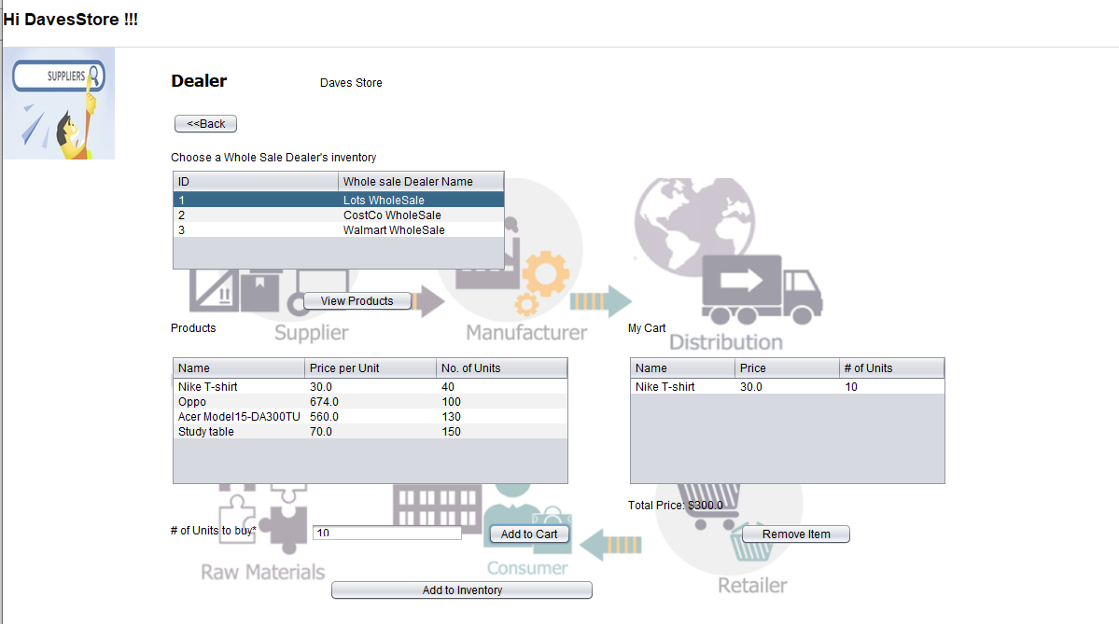
Thrift Store - E-commerce - Dealer

Slide 7
Thrift Store - E-commerce - Shopping
Allows customer to browse through all the products in store that are made available through the dealers.
Features:
Customer can browse through all items using price sorter to get Lowest to Highest or vice-versa.
Customer can filter items based on Category filter.
Customer can try searching for an item by entering any or all keywords of that item.
Any returning customer can directly review items in their Cart and proceed with Checkout. Any cart, unless emptied by a customer, will always be retained.

Slide 8
Thrift Store - E-commerce Shopping - Product Selection
On selecting an item from the list, the customer is shown more details of the item along with a larger dimension image for clearer product details.
Features:
Customer is shown the current quantity of that item currently available in store, so that he/she can decide on adding quantity accordingly to their cart.
Similar items from the same category as the original product are shown below, to increase customer engagement.

Slide 9
Thrift Store - E-commerce Shopping - Cart
Every item selected by customer will be available for review in the Cart.
Features:
Customer can update quantity of any item - given that it is available in store.
Customer can delete any product if he/she so requires.
Customer will be encouraged to buy items worth $100 or more, and will be provided with a 15% off discount, applied immediately if the total crosses the criteria.

Slide 10
Thrift Store - E-commerce Shopping - Payment
Once the customer decides to checkout a cart, he/she will be directed to the payment form.
Features:
Displays customer details and final amount to be paid.
Customer has 3 payment methods to choose from - Cash on Delivery, Credit Card and Debit Card.
If the customer chooses either Credit Card or Debit Card, he/she is prompted to add extra details of the card being used.
Order gets created only after payment details are validated.

Slide 11
Thrift Store - E-commerce Shopping - Order Status
Only after an order is successfully placed, the quantity for that order is reduced from the in store stock.
After placing order, customer can view the order history any time.
Features:
The customer can check Order Status on any of the present orders.
On clicking any order, the customer can view the products, their quantities purchased and other payment details.

Slide 12
Scenario - What happens if?
Customer did not find desired item in Ads posted
OR
Customer did not find desired item in e-Commerce
OR
Customer finds price of item in e-Commerce high

Slide 13
Thrift Store - E-commerce - E-Auction
In Thrift Store, we have additional functionality of e-Auction for the customer. The policy for the online e-Auction in Thrift Store is that once after the customer places an order. The E-Auction on Thrift Store enables the Dealers to place their least sold products (products purchased lesser than twice by the customer) will be up for Auction.
Features:
The Auction Consultants' role has a login through which he logs in and can see a table with the list of products that qualify for auctioning.
The Auction Consultants can enter the quantity that needs to be added to the auction table list.

Slide 14
Thrift Store - E-commerce - E-Auction
When listing the product for Auction, the price will get reduced by 40% from the original price for the customer.
When the customer logs in, he can view the Auction list and can bid for a price that is maximum than the base price.
Similarly, other customers can also log in and place their highest bid price. Once after getting a maximum of three bids from the customer the Auction Consultant will sell the product to the customer with the maximum bid price.
Once the product got sold it will be removed from the auction list. The Customer who has placed bids can see the order in their order status table if the Auctioned product got sold to them.

Slide 15
Thrift Store-E-commerce -Customer Service Request
In Thrift Store, we have provided Customers with a Customer Service functionality where the customer service representative can assist the customers with the issue via the online chat option.
Features:
Once after the customer places an order if he was facing some issue regarding the product shipping (or) maintenance then he can post a comment on the issue to the customer service.
The Customer Service Request role has a login through which he can log in and check the issue request date along with the comment from the customer.

Slide 16
Thrift Store-E-commerce -Customer Service Request
The customer service can assign the order to a shipping company and can also submit a response to the customer.
Similarly, when a customer request maintenance the customer service request can also assign maintenance for an order.
The Customer service request can also update the status of the shipping (or) maintenance in the table for the customers.
Once the status got changed to “Completed” the resolve date will get updated accordingly in the table for the customer.

Slide 17
Thrift Store - E-commerce - Shipping
The rise of eCommerce has put extra emphasis on convenience and shipping. While the two go hand-in-hand, shipping has become an essential component in successful eCommerce businesses. The ability to order online and receive the product promptly can influence buyers, drive sales, and create return visitors. Similarly, Thrift Store also provides the customers with timely shipping of their orders.
Features:
Once after the customer places an order from a particular dealer and when the Dealer logs in then he can see the list of orders placed by the

Slide 18
Thrift Store - E-commerce - Shipping
customer in the table. The Dealer can assign the order to a shipping company.
The Shipping Company role has a log-in through which he can log in and check the orders that have been assigned under their company. The shipping admin can also update the status to the customer.
Once the shipment has been assigned if the customer faces any issue with the order shipment then he can reach out to Customer service by posting comments about the issue.
The Customer Service role can assist the customer by assigning the order to a shipping company (or) by getting the status on the order from the

Slide 19
Thrift Store - E-commerce - Shipping
shipping company and update the status to the customer via comments.
The Customer Service can also update the status of the order customer in the table. Once the status gets changed to “Completed” the resolve date for the issue will be automatically updated in the table

Slide 20
Customer - SignUp
New Customer will be able to sign up in the ThriftStore.
On activation, will notified through email notification.
Customer can login and enjoy buying and selling by viewing ad, posting ad, buying products from ecommerce and auction consultants.

Slide 21
Thrift Store - Manufacturer
Thrift Store has its own Manufactured products.
Products from thrift shop can be bought by customers from across the globe.

Slide 22
Customer - Post Ad/View Ad/My Ads
Customer will provide with the basic details of the product
All the ads posted by other sellers in the View Ads panel.
Customer can now bid an amount for the product he is interested in buying
Buyer can view the work request and can accept or reject the offer

Slide 23
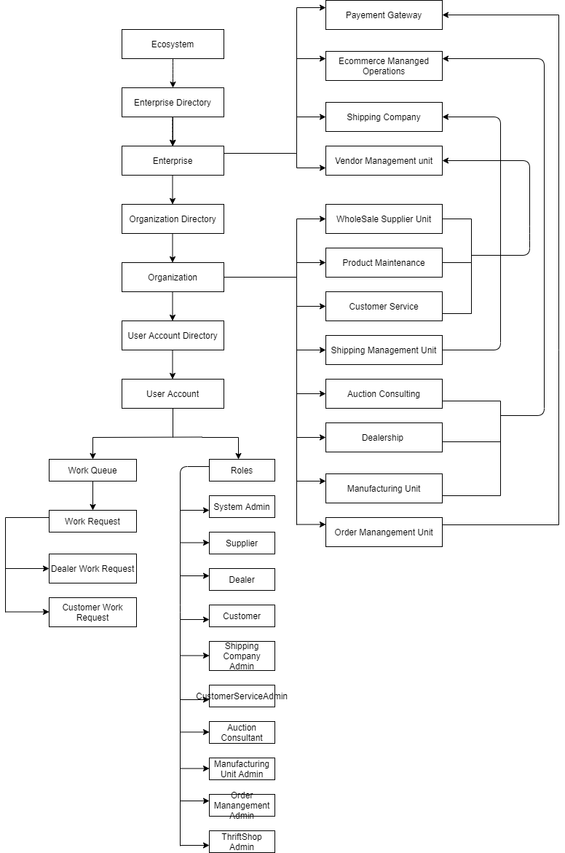
Thrift Store - UML diagram
UML diagram :

Slide 24
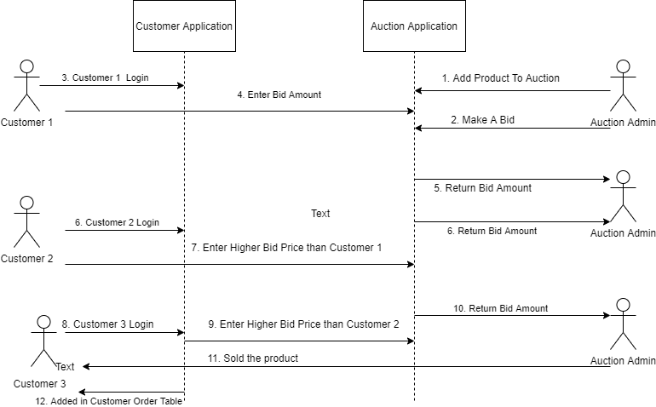
Thrift Store - Sequence Diagram
Auction Sequence Diagram :

